Slide 1
February 28, 2014 | Boston, MA
Enhancing Capacity Markets to Improve Resource Performance and Investment in New England
Restructuring Roundtable
Robert Ethier
Vice President, market development

Slide 2

ISO New England’s Strategic Planning Initiative
Focused on developing solutions to the top five challenges facing the region
Resource Performance and Flexibility
Increased Reliance on Natural Gas-Fired Capacity
Retirement of Generators
Integration of a Greater Level of Variable Resources
Alignment of Markets with Planning

Slide 3
Electric Grid is Undergoing Rapid Transformation
- Generation shifting from oil, coal and nuclear to natural gas and renewables
- Public policy driving renewables and “behind the meter” DG/DR and EE investment
Long Term Consequence: Greater operational uncertainty/variability + lowered energy market revenues = need for resource performance/flexibility + greater dependency on capacity market revenues
* Resources in 2020 assume approx. 5,000 MW of new resources proposed in the ISO Queue as of April 2013 (primarily natural gas and wind); and approx. 3,200 MW of non-price retirement requests for coal, oil and nuclear resources as of October 2013.

Slide 4
Resource Shift Creates Reliability Challenges
ISO New England is increasingly reliant on resources with uncertain performance and availability
  Intermittent resource growth with inherently uncertain output
    ISO forecasts >600 MW of solar PV will come online over the next 10 years
    Multiple transmission proposals to increase access to renewable energy
  Natural gas resources lack firm gas transportation or fuel storage and rely on “just-in-time” fuel supply
  Coal, oil-steam fleet is being displaced by more efficient resources
ISO has estimated up to 8,300 MW of non-gas-fired generation is “at risk” for retirement by 2020 (28 older oil and coal units)
  If all retire, ISO estimates 6,300 MW of new or repowered capacity will be needed in the region

Slide 5
“At Risk” Unit Retirements Have Begun
More than 4,000 MW of generation and demand resources plan to retire, including almost 2,700 MW of coal and oil units the ISO identified as “at risk”
Major Retirement Requests:
Total MW Retiring in New England*
Connecticut | 528 MW
Maine | 159 MW
Massachusetts | 2,682 MW
New Hampshire | 56 MW
Rhode Island | 64 MW
Vermont | 666 MW
Total | 4,155 MW
Salem Harbor Station (749 MW)
  4 units (coal & oil)
Norwalk Harbor Station (342 MW)
  3 units (oil)
Brayton Point Station (1,535 MW)
  4 units (coal & oil)
Vermont Yankee Station (604 MW)
  1 unit (nuclear)
*Megawatts based on relevant Forward Capacity Auction (FCA) summer qualified capacity (NOTE: total includes full and partial generator and demand response Non-Price Retirement (NPR) requests for Capacity Commitment Period (CCP) 2013-2014 through CCP 2017-2018)
Source: Status of Non-Price Retirement Requests; December 20, 2013

Slide 6
Average Fleet Forced-Outage Rate has Increased

Slide 7
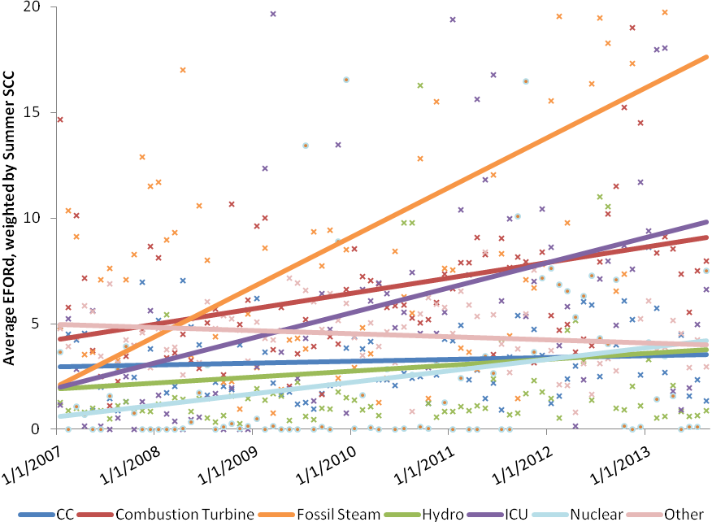
Fossil-Steam-Unit Unavailability is Increasing
Fleet response during contingencies and stressed system conditions is a growing problem – leading to a NERC violation and a number of very close calls

Slide 8
Region is Taking Action to Improve Electric Market Efficiency and Enhance Gas-Electric Coordination
Recently Implemented (2012–2013) | Near-Term Actions (2013–2014) | Longer-Term Actions (2014–2019)
Ongoing improvements to information sharing with natural gas pipelines Moved Day-Ahead Market timeline in 2013 Increased forward reserve requirements in 2013 FERC clarification of generator obligations (must purchase fuel unless physically unavailable – economics is not an excuse) | Tightened FCM Shortage Event trigger (effective Nov. 2013) Developed energy market offer-flexibility enhancements (effective Dec. 2014) Change NCPC cost allocation to drive more load to Day Ahead Market | Strengthen Forward Capacity Market Performance Incentives “Pay-for-Performance” (will apply to 2018-19 commitment period) Implement Demand Curve and improve zonal modeling in capacity market Further improvements to energy market pricing New England States are driving investments in additional gas pipelines, and transmission to enable additional renewable energy

Slide 9
Problems with Existing Capacity Market Design
Capacity payments are poorly linked to resource performance
Consequences for non-performance are negligible
Pervasive and worsening performance of existing generation fleet in New England
Lack of incentive for resource owners to make investments to ensure they can provide energy and reserves when needed
“Missing money” paid to all resources, instead of those that invest to be able to perform during scarcity conditions
Delays exit of poor performers from the market; creates a bias in the FCM to clear less-reliable resources
Lack of investment poses serious threats to system reliability
ISO’s pay-for-performance proposal is a comprehensive solution to these problems

Slide 10
Sound Principles for Capacity Market Reforms
Reward outputs (power delivered), do not specify inputs
  Let suppliers identify least-cost solutions, bearing risks and rewards
Redefine performance measures for capacity resources
  Delivery of energy and reserves during (reserve) scarcity conditions
  Not peak period ‘availability,’ or EFOR-based measures
Better align resources’ financial incentives with the
value of reliable service during tight system conditions
  Mimic the performance incentives of an efficient energy market,
  with the reduced volatility that a forward market provides

Slide 11
FCM Pay for Performance – Major Elements
FCM obligations to mirror a standard incentive contract
  Base payment and a performance payment
Performance Payment
  Determined by a resource’s performance during shortage conditions
  May be positive or negative (on top of base payment)
Resource Neutral
  All resources have same base and performance payment rate
Who pays what?
  Buyers (loads) pay the base payment set by FCA clearing price
  Performance payments are transfers among suppliers

Slide 12
FCM Pay for Performance Creates a Sound Capacity Product Definition and Obligations
In simple terms: Capacity should be paid for what it delivers
  Analogy: Does your hotel keep your deposit when it cannot honor your reservation? Of course not.
In precise terms: Capacity becomes a standard forward good
  Two-settlement principle (think of DA forward energy markets)
  A scarcity pricing premium as RT incentive in tight system conditions
Key outcomes:
  Strong performance incentives of an efficient energy market
  Reduced revenue volatility from a long-forward contract market;
  Stability of system reliability (capacity levels) over time

Slide 13
ISO New England’s Proposed Reforms:
Make Capacity a Proper Forward-Sold Good
Forward-Sold Goods
Initial revenue on fwd sale
Specifies a forward financial commitment (‘position’)
2nd Settlement based on deviations at delivery …
… at a contract rate, or at replacement (floating) price
ISO’s Capacity Reforms
Auction-based fwd sale (FCA)
Pro-rata share of system requirements (load + reserves) during RT reserve shortages
2nd settlement for delivery (energy + reserves) deviation from system share
At (high) tariff-specified rate (analogous to scarcity pricing)

Slide 14
Benefits of the Pay for Performance Design
Greater operational-related investments at existing resources to improve resource performance
  E.g., fuel arrangements and/or secondary fuel supplies
Efficient resource evolution. Strong incentives for investment in new capacity that is either:
  Low-cost and highly reliable (nearly always operating); or
  Highly flexible and highly reliable (gets online quickly and reliably)
A more reliable power system at lowest possible cost
  Market rewards suppliers that deliver most cost-effective solutions

Slide 15
FERC to Choose Between Competing Visions to Improve Performance of Capacity Resources
ISO: Pay for Performance in FCM
NEPOOL: Alternative Proposal
Strongly links capacity payments to resource performance during scarcity conditions
  Pay resources that perform well
  Impose real consequences if resources fail to deliver what consumers paid for
No exemptions – suppliers (not consumers) bear risks and rewards associated with resource performance
Resource neutral
As renewable energy is added to the system and EE and DG take demand off the system (reducing infra-marginal revenues in the energy market), we won’t achieve the needed level of reliability without the right incentives
Increases energy price during scarcity conditions, but the amount is insufficient to incent investment in reliability
Eliminates Shortage Event mechanism in the FCM, which weakens resource performance incentives
Adds a long-term availability incentive, but fails to link payments to actual performance during scarcity conditions
Adds further exemptions, which further weakens performance penalties
Providing capacity payments to support steel-in-the-ground, without a strong link to performance, is insufficient to address serious reliability threats
Exacerbates the existing, adverse selection problem by attracting, and biasing revenues towards, poorer performing resources

Slide 16
Complementary Energy Market Changes Underway
But by themselves do not mitigate need for PFP, and do not send similar investment incentives
Energy Market Offer Flexibility (2014)
  Allows suppliers to update supply offer prices intra-day
  Improves generators’ flexibility to incorporate current fuel costs into energy prices during volatile market conditions;
  Improves incentives to procure fuel to honor ISO dispatch schedules
Reserve Market Enhancements (2012/13)
  Sends stronger, more frequent market price signals when system conditions are likely to be tight
  Enhances incentives to procure fuel to honor ISO dispatch instructions and rewards resources that perform in stressed system conditions

Slide 17
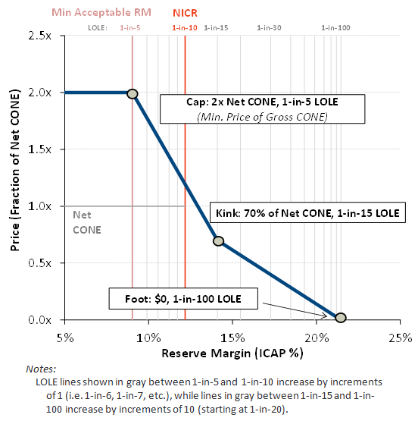
Sloped Demand Curve Included in Next Capacity Auction (FCA 9)
Solve significant flaws in the existing FCM design
  Eliminate the binary nature of existing vertical demand curve
  Smooth the boom-and-bust cycle of investment when region is either just short, or just long on capacity
Alleviate the need for administrative pricing rules
  Insufficient competition and insufficient supply
Note: This graphic is for illustrative purposes and was used during stakeholder discussions

Slide 18
ISO Aims to Implement PFP and Demand Curve Proposals by the Next Auction
Concluded stakeholder process for PFP in 2013, culminating in NEPOOL votes in November-December
  ISO’s Pay for Performance and NEPOOL alternative filed in December as “jump ball” proposal to FERC
  ISO has requested a FERC order by May 14
In January, FERC ordered ISO to file a proposal for a downward-sloping demand curve for the next auction
  Filing due April 1
  Next auction, FCA-9, scheduled for February 2015
    Qualification deadline is June 2014
  FCA-9 capacity commitment period begins June 1, 2018

Slide 19
Conclusions
New England has a growing reliability problem due to inadequate gas pipeline infrastructure and poor performance by some resources and a need to balance an increasing amount of intermittent renewable energy
New England states are driving additional investments in behind-the-meter resources (EE, DR, and DG) in combination with grid-connected, intermittent resources (wind and solar energy)
Region needs to clarify and strengthen the product definition and incentives in the capacity market
  FERC needs to give guidance on which of two competing visions to implement
  Sloped demand curve will improve investment climate

